Slide 1


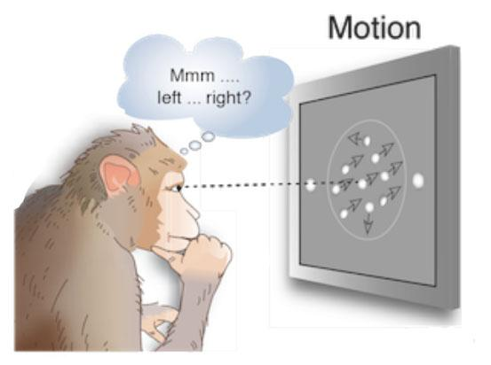
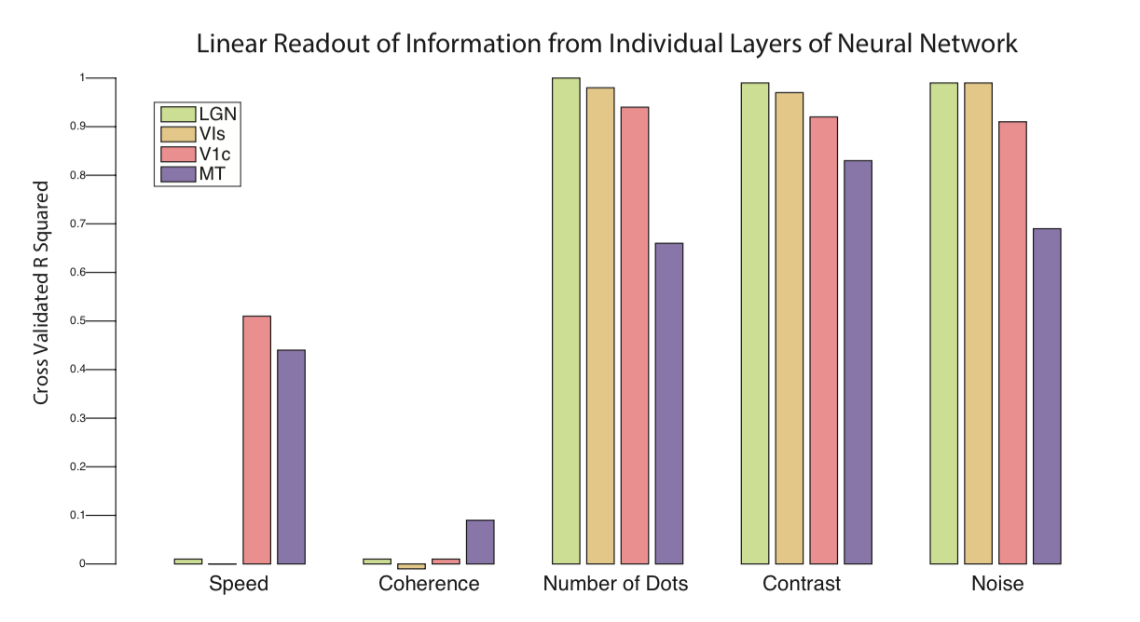
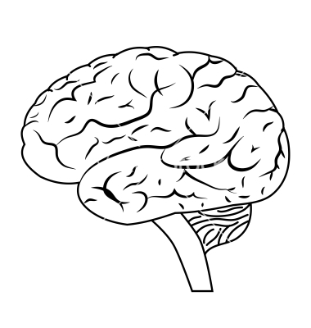
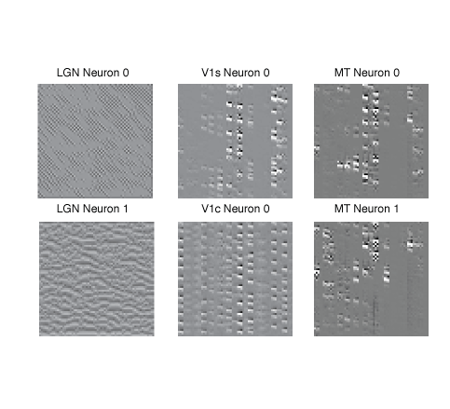

Applying 3D Deep Neural Networks to Human Psychophysics
Daniel Birman, Dylan Cable, Steeve Laquitaine
Department of Psychology
Motivation: Why model human psychophysics?
LGN
Readout: Does our model represent important
motion features?
Input:
16x32x32
LGN
LGN
LGN
LGN
Conv: 1x3x3
LGN
Training models of the human nervous system to perform the same task as humans is a useful tool to help us understand human behavior (Yamins et al. PNAS 2014). We built a neural network based on the human visual stream up to cortical area MT. We trained
LGN
LGN
V1s
1x3x3
LGN
LGN
LGN
LGN
LGN
MT
5x3x3
V1c
1x3x3
8 Direction Softmax
Readout
LIP
LGN
V1
MT
our model to complete a simple behavioral task: discriminate direction. Our model is a modernization of an older model without constraints on the characteristics of internal feature representations (Simoncelli et al. PNAS 1996).
Retina
To understand the internal features represented by our model we computed regressions predicting feature strength from layer outputs. To reduce dimensionality we averaged outputs across both space and time. We found that, although not explicitly trained for them, our model represented aspects of our motion stimulus in specific layers.
Stimulus
Validation: Classifying 8 direction motion
Humans vs. Machines: Performance on an untrained psychophysics task
Feature Inversion
GIF videos of our motion stimuli and feature inversions are available on our website.
Acknowledgments
Thank you to the CS231n staff and our TA Lane McIntosh for helpful comments on earlier iterations of our project!
We used our trained model to perform two basic psychophysical tasks to compare its performance against human behavior. We looked at contrast discrimination and motion coherence discrimination, two tasks that can be done on the same stimulus that we used to train our model (see our website for stimulus examples). Above we plot the amount of stimulus strength difference needed to discriminate which of two patches of dots had higher contrast or greater motion coherence. We compare these results against a model-based linear readout from specific layers. We found that for contrast both human and model performance are qualitatively similar, while for motion coherence our model does not appear to capture the necessary features to decode motion strength in a linear manner--we expect this is due to the nonlinear representation of motion coherence in the MT layer of our model.
Contact: dbirman@stanford.edu, dcable@stanford.edu, steeve@stanford.edu
http://gru.stanford.edu/doku.php/deepmotion

